Slide 1
CQC BOOK GUIDE
Employee name: 許氏玲
Department: IT-SFIS-C03
Prepare date: 08-10-2021

Slide 2
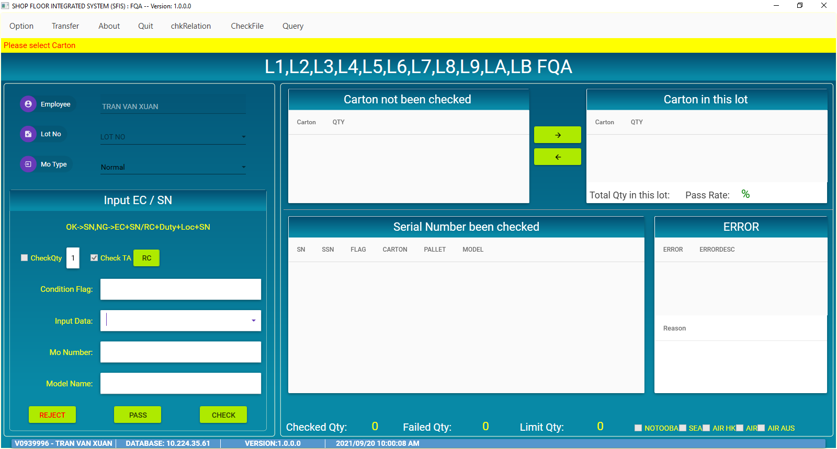
CQC BOOK GUIDE
1.MAIN INTERFACE ITEM
1. Menu

Slide 3
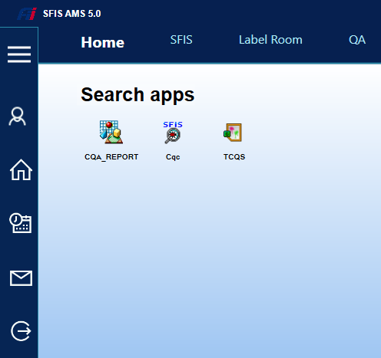
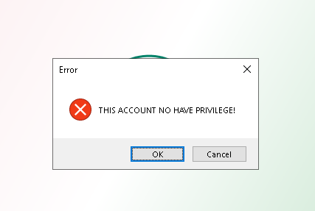
CQC BOOK GUIDE
2.LOGIN
Login to SFIS_AMS then double click on CQC program.
Login OK
Login NG
If account no have privilege, please contact with IT for permission.

Slide 4
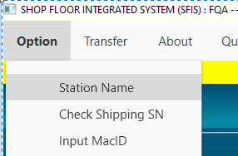
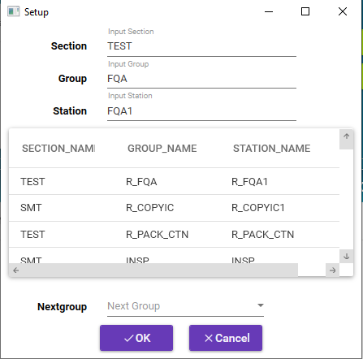
CQC BOOK GUIDE
3.SETUP STATION NAME
1
2
3
Setup station name follow step bellow:
Choose Option
Choose Station Name
Choose station
Click OK
4

Slide 5
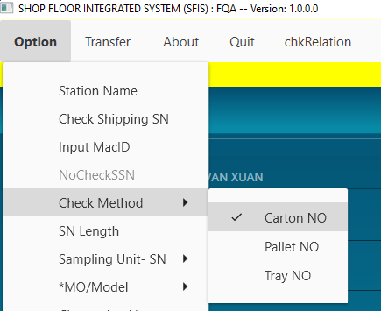
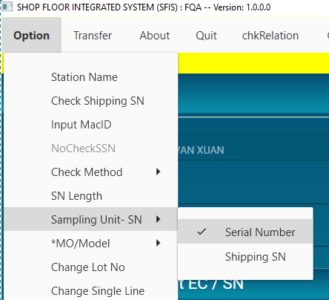
CQC BOOK GUIDE
4.OTHER SETUP
Choose check CQC by Carton or Pallet
Choose scan by serial_number or shipping sn

Slide 6
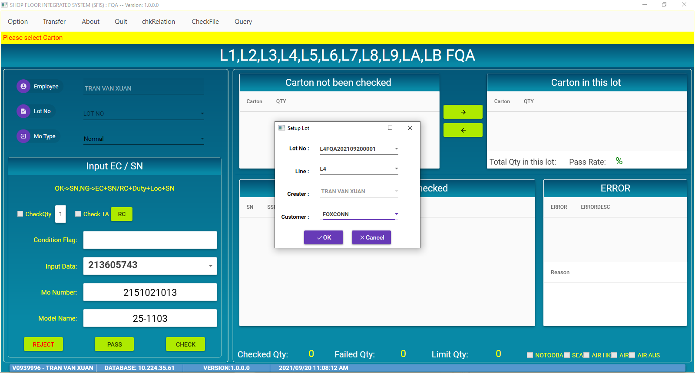
CQC BOOK GUIDE
5.OPERATION WITH PROGRAM
Information of employee and LOT_NO
Scan first PCB LOT_NO code will automatically be generated
Scan input serial_number or shipping_sn
Click button OK
Information of product

Slide 7
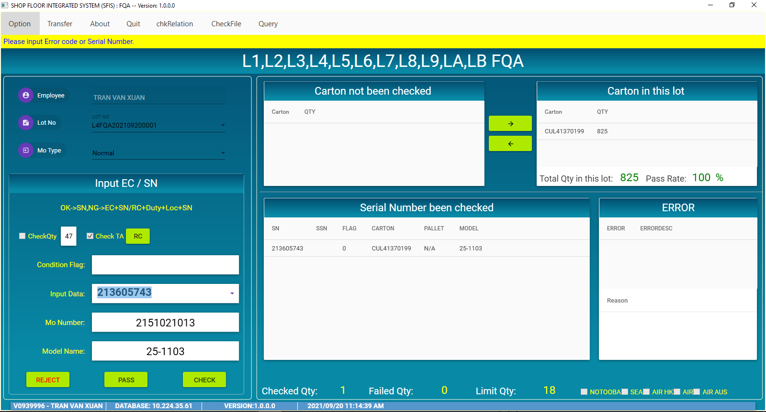
CQC BOOK GUIDE
5.OPERATION WITH PROGRAM
Information quantity PCB in carton
Quantity PCB need check
Then click button OK, information of PCB will be displayed here

Slide 8
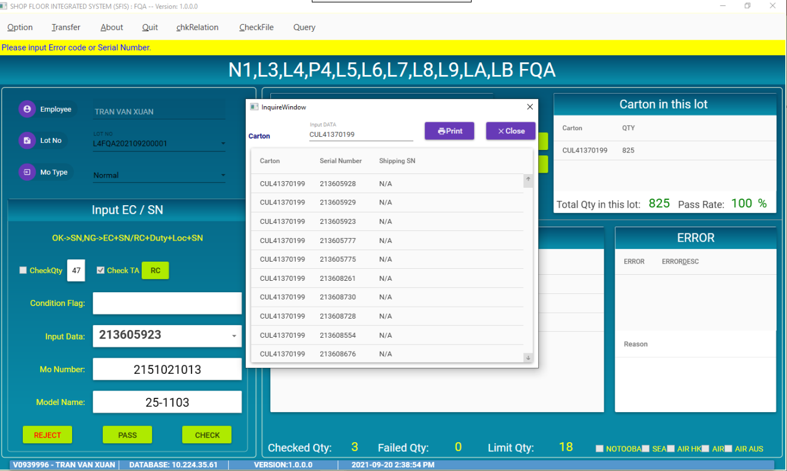
CQC BOOK GUIDE
5.OPERATION WITH PROGRAM
Double click Input data
Information of carton being scanned

Slide 9
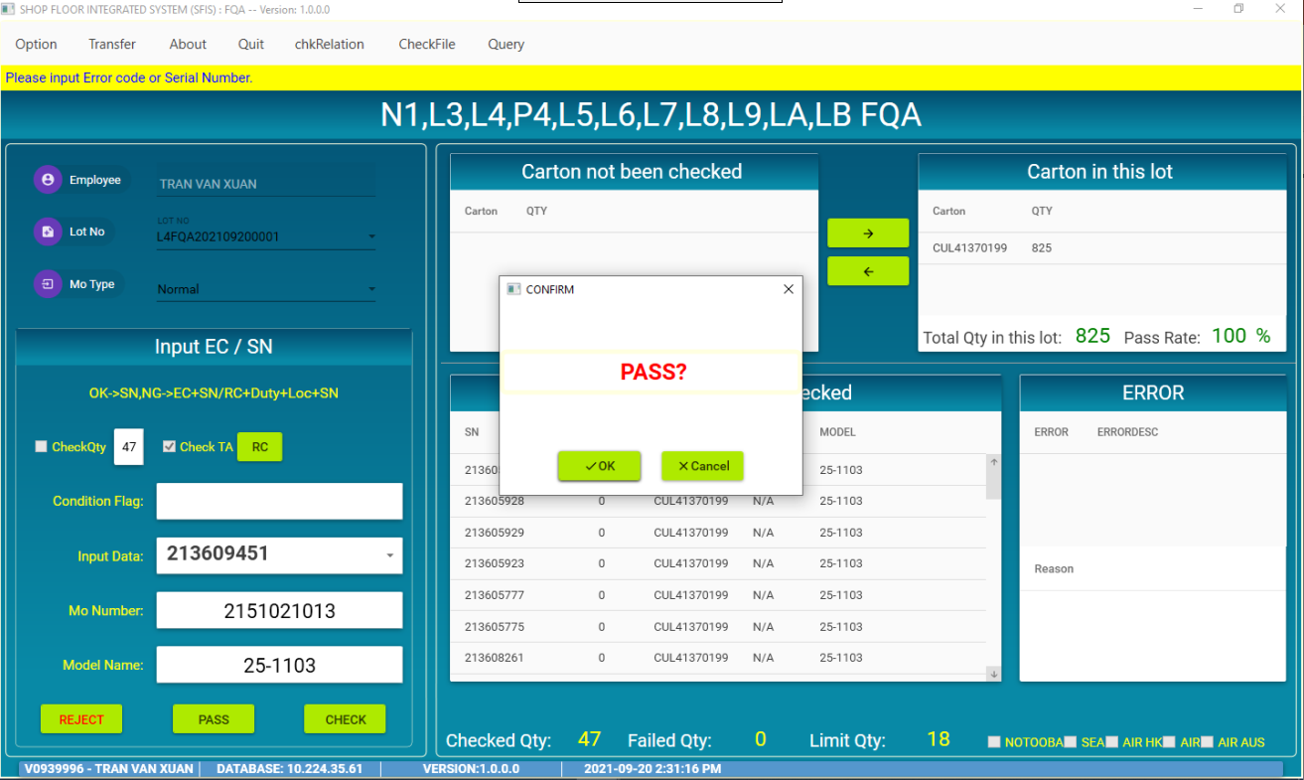
CQC BOOK GUIDE
5.OPERATION WITH PROGRAM
Then click OK confirm LOT_NO pass station.
Click PASS button
Scan enough PCB need check

Slide 10
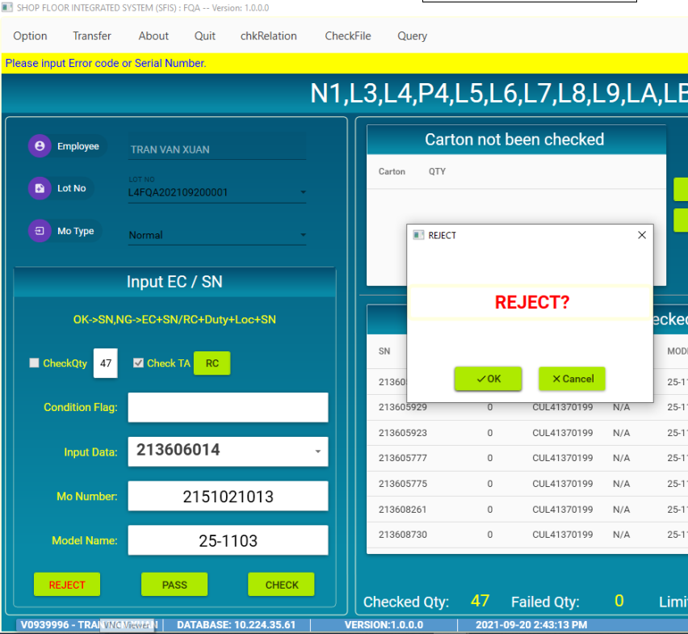
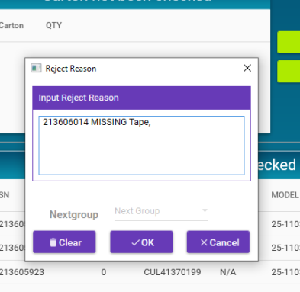
CQC BOOK GUIDE
5.OPERATION WITH PROGRAM
Input Reject reason
Click OK confirm reject LOT_NO
Click button OK
If want reject carton or pallet, click button REJECT

Slide 11
CQC BOOK GUIDE
THANKS FOR WATCHING

